Slide 1


Slide 2
Service Discovery - Monolithic

Slide 3
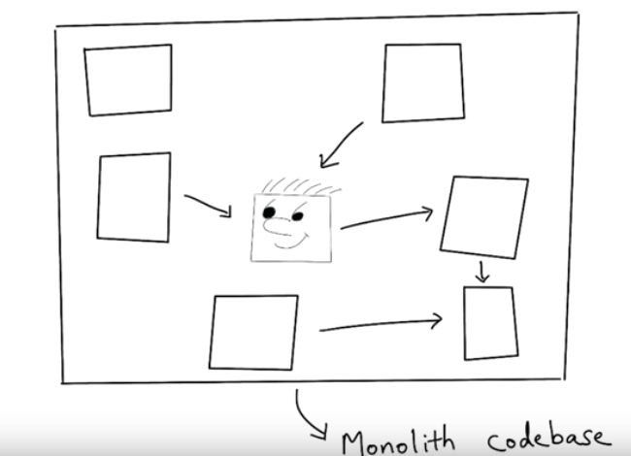
Service Discovery - Monolithic

Slide 4
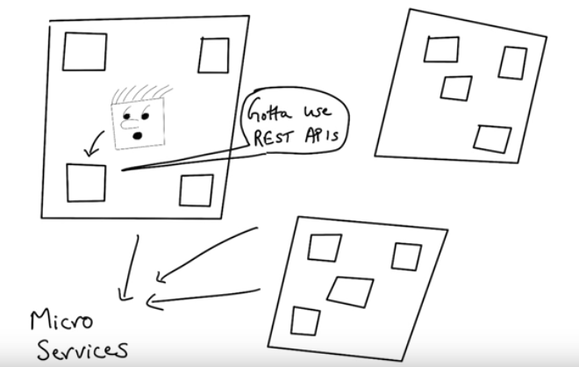
Service Discovery - Microservices

Slide 5
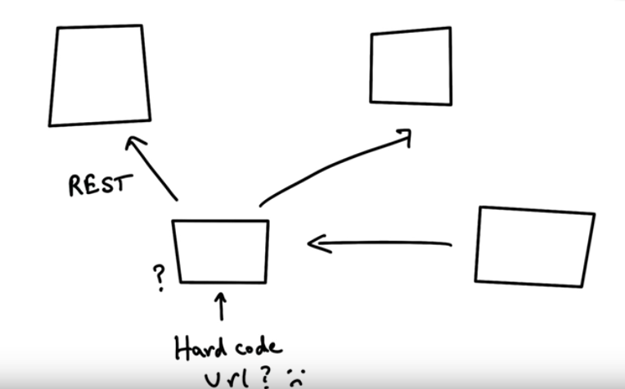
Why Service Discovery?

Slide 6
Service Register - Lookup

Slide 7
Client Side Service Discovery

Slide 8
Server Side Service Discovery

Slide 9
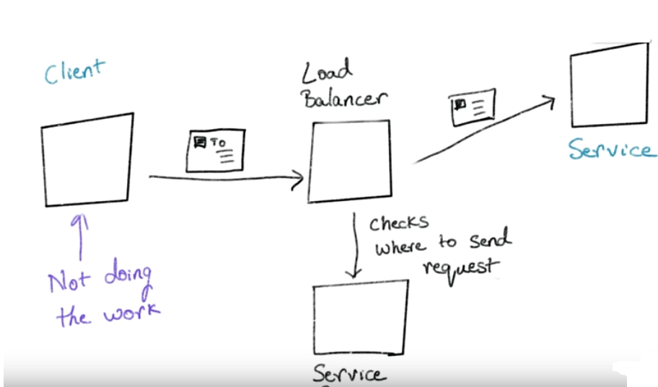
Server Side Service Discovery

